Slide 1
Tutorial 3_datapath animation slides

Slide 2
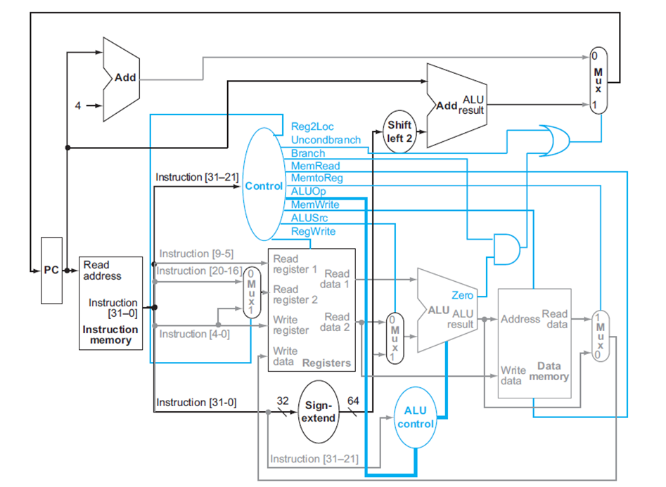

Slide 3
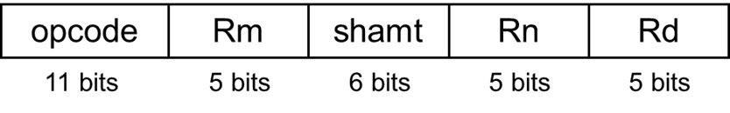
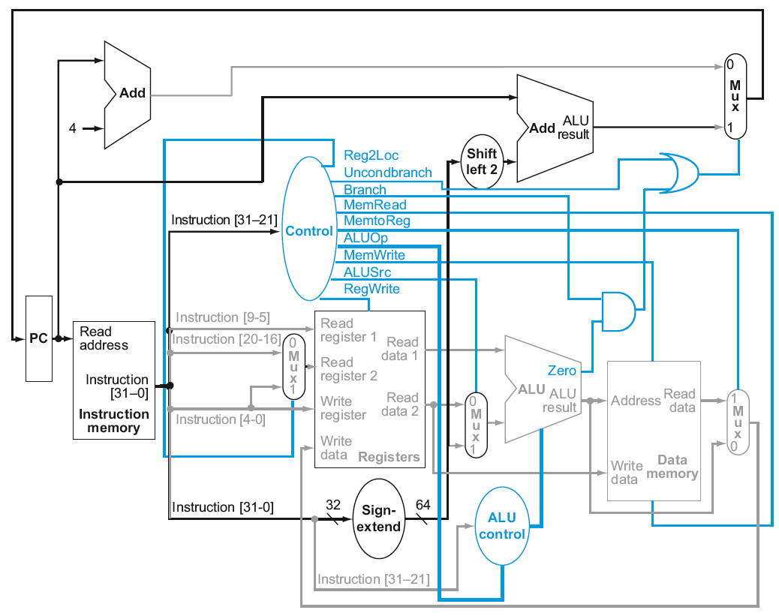
Complete Datapath
Operation Rd, Rn, Rm
Register or R format
1
10
8
0
0
12
add
0
operation Rd, Rn, Rm
example: ADD X12, X10, X8
means: [X12] ←[X10]+[X8]

Slide 4
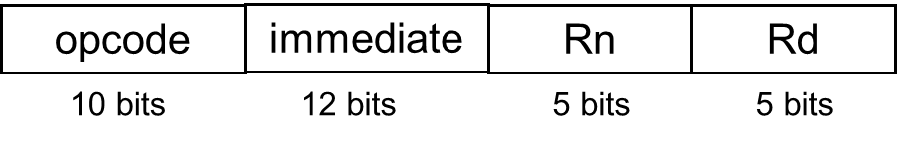
Complete Datapath
Operation Rd, Rn, #immediate
Immediate or I format
1
10
1
0
12
8
operation Rd, Rn, #8
example: ADDI X12, X10, #8
means: [X12] ←[X10]+[8]
add

Slide 5
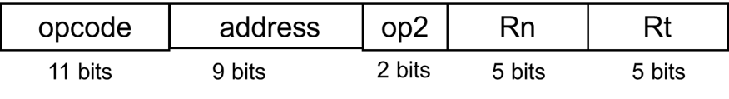
Complete Datapath
Operation Rt, [Rn, address]
Data transfer or D format
1
10
Mem[[R10]+8]
1
1
12
8
operation RT, [Rn, #8]
example: LDUR X12, [X10, #8]
means: [X12] ←mem[[X10]+[8]]
add
1

Slide 6
Complete Datapath
Operation Rt, [Rn, address]
Data transfer or D format
10
1
12
Mem[[R10]+8]
1
1
8
operation Rt, [Rn, #8]
example: STUR X12, [X10, #8]
means: [X12] →mem[[X10]+[8]]
add

Slide 7
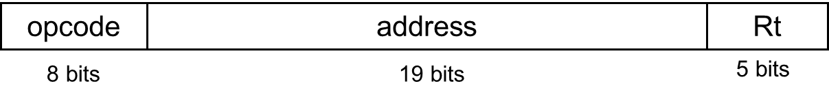
Complete Datapath
Operation Rt, address
Conditional branch or CB format
1
1
1
1
operation Rt, #address
example: CBZ X10, #1
means: [newPC] ←PC +4*1 ; if X10=0
Pass b

Slide 8
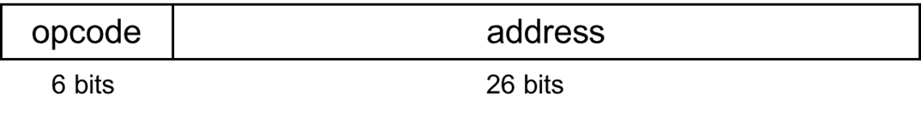
Complete Datapath
Operation address
Un Conditional branch or B format
1
1
operation #address
example: B #1
means: [newPC] ←PC + 4*1 ;

